Slide 1
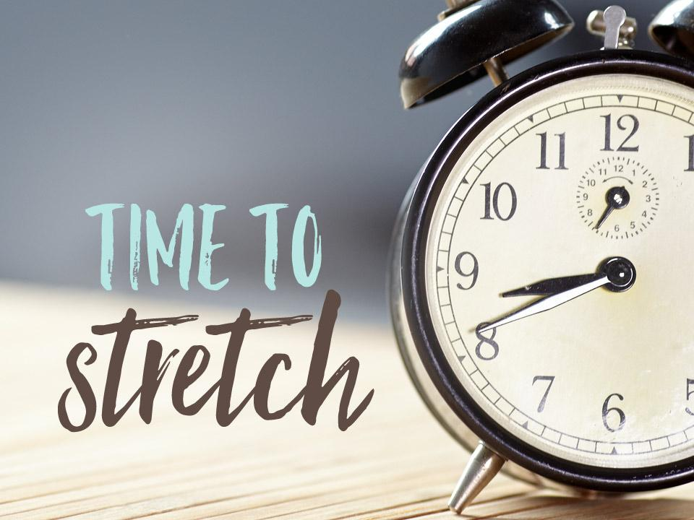
Project Proposal:
Health Buzz
A health reminder
By Team 2:
Yang Hyeonseo
Song UGyeong
Jang Donghae
Jasmine Abtahi
Notes:
Suggests: decide on our main app color (both theme and text) and apply to ppt.

Slide 2
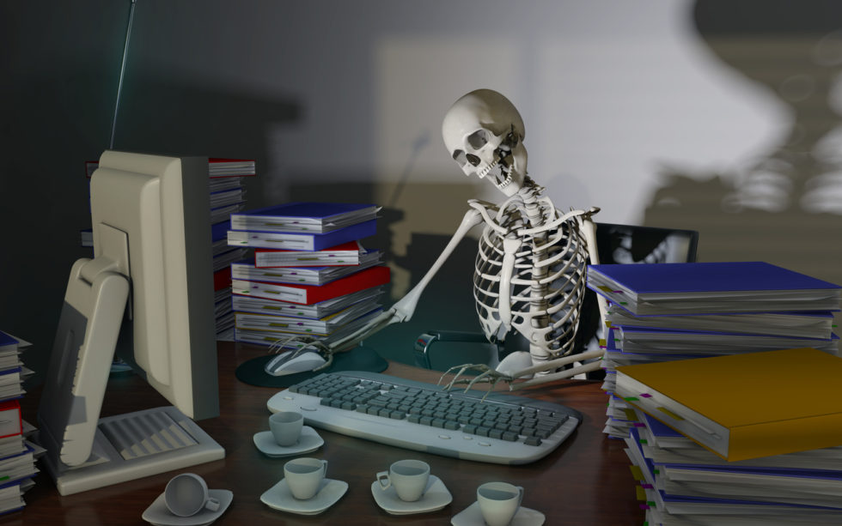
Target users and the problem they are facing
Nowadays, people have a hard time studying, coding and doing work on their seat. While doing these burdensome things, they sometimes forget to do a stretching or taking a walk. It would be bad for their health, and also for their work efficiency.
Target user group : People who are sitting long time with bad pose while doing a work for a long time.

Slide 3


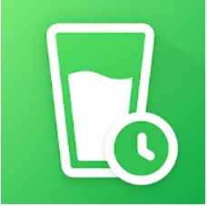
Existing solutions and their limitations
Limitation
They give alerts based on interval and time which user previously set. These methods can’t consider user’s real-time actions
Move
Water drink reminder
Stand up
Notes:
This is existing app examples
Move - Giving reminder based on the user’s setting for the interval, and break time length
Stand up - Similar to above, which is based on user’s working schedule
Water drink reminder - Giving reminder based on the user’s setting. User could write down their water drinking, and app would analyze it
Limitation - These methods can’t consider user’s real-time actions which could be differ from their previous schedule.

Slide 4
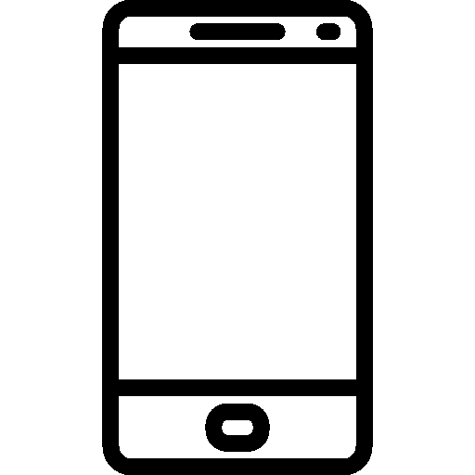
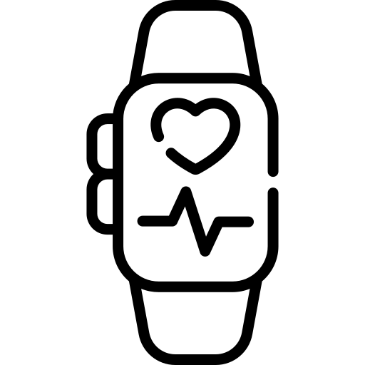
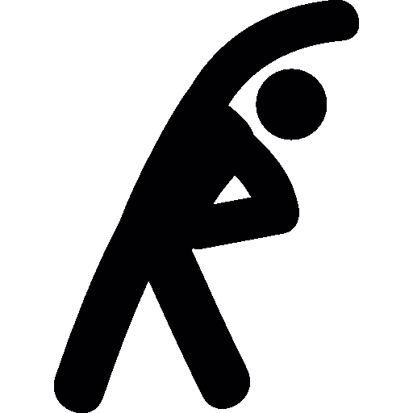

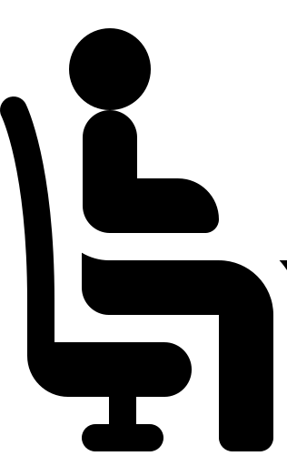
The key solution approach to tackle the problem
Classifier
Giving buzz
Stretch your shoulder!
Notes:
To consider user’s real-time actions, our app will use data from mobile phone and smartwatch sensor. By using these data, we can make model which classifies user’s current state.
When user is sitting too long, app will give alert to user.

Slide 5
Usage scenarios
Users install the app.
The app detects their poses and give alert to user when they sit for a long time without stretching.
The app recommends good stretching strategy for the user, based on the poses detected.
The app also checks whether the person drank enough water and alerts the user to drink some water if needed. (Potential, by studying hand movements to grab the cup)

Slide 6
The proposed system overview and specific functions
Sense the user’s pose in the background.
Remember when the user last drank water.
Processing
Alert user to do stretching
Recommend some appropriate stretching strategy for the user.
Alert the user to drink some water.

Slide 7
Expected (technical) challenges and solution ideas
Sense body motions and state(ex: not moving, unhealthy pose or drinking water)
Sol: Based on smartwatch’s sensing data(GPS, distance to body, purse or acceleration (or visual data if possible)), we can use algorithm or ML to catch them.
Recommend customized stretches
Sol: Using personal state and pose data history(drinking everyday or not moving wrist much), we can recommend customized stretches.
Recognize good and bad pose
Sol: We can get each pose data for sensing from users in initialization.
Save battery
Sol: Consistently detect pose while the user is moving, and sleep while the user stands still. Then periodically check if the user is still have not moved.

Slide 8
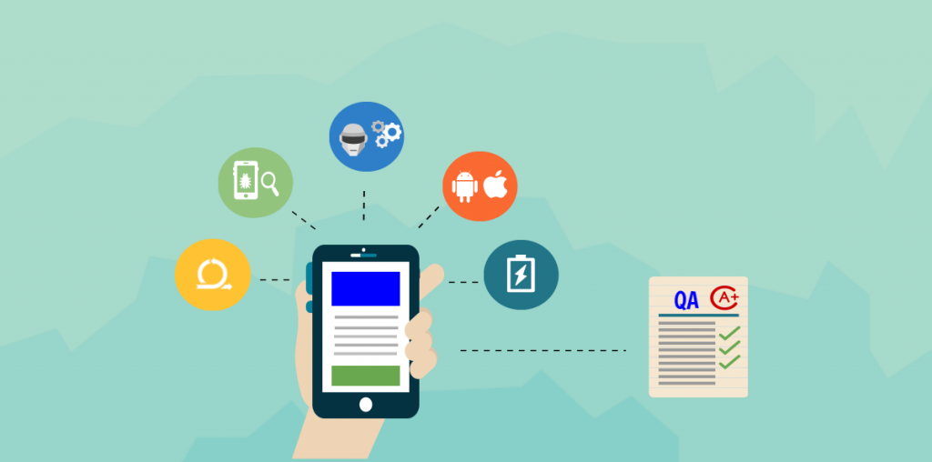
Evaluation strategy
Compare our motion sensing results with real pose data to get accuracy.
Check if our app recommends proper stretching at intended timing.
Test the app functions and do proper QA

Slide 9
Overall project plan (by Nov. 1st)
0. Build a skeleton | Everyone
1. Get friendly with smartwatch and phone sensors | Everyone
2. Collect data from sensors | Hyeonseo & Jasmine
3. Study models to detect pose | Everyone (Donghae will lead)
4. Train model and deployment | Donghae & UGyeong
5. Add function and improve UI | UGyeong & Hyeonseo & Jasmine

Slide 10
Final deliverable
Alarm app that notifies you to correct your bad gesture/pose, gives appropriate stretching exercises to do between your work hours and tracks the amount of water you drink and sends buzz to remind you..
Smart watch/phone will buzz to remind you it’s time to do some stretching, with recommendations.
Buzz for drink water and other health related reminders. (long term plan: Smoking detection, Medicine reminder, sleep reminder, meal reminder, etc)
Ability to customize.
Notes:
Novel idea. Effectiveness. (users will see the result on their overall health) improve productivity. (app will handle the job in background while you’re focusing on your work) Secure.(won’t share data). Health care apps are trending (people care about improving health more then before that’s why smart watch market is growing too. Organized and simple, yet functional and personalized. Potential to grow bigger (adding more health related functions - more devices -> better pose detection)

Slide 11
Success criteria
Novel idea
Effective
Improves productivity
Secure
Trendness
Simple and organized, yet functional and personalized
Potential to grow bigger
Notes:
Novel idea. Effectiveness. (users will see the result on their overall health) improve productivity. (app will handle the job in background while you’re focusing on your work) Secure.(won’t share data). Health care apps are trending (people care about improving health more then before that’s why smart watch market is growing too. Organized and simple, yet functional and personalized. Potential to grow bigger (adding more health related functions - more devices -> better pose detection)

Slide 12
Thank you!
Notes:
Suggests: decide on our main app color (both theme and text) and apply to ppt.

